Slide 1

Snapshot isolation
Gerardo Avila COMP 335/488 – Formal Methods

Slide 2
What is Snapshot Isolation?
Method commonly used in SQL Servers
Eliminates all phantoms – dirty, non-repeatable, and phantom reads
Very similar to the Serializable Isolation
Like Serializable Isolation, Snapshot Isolation guarantees highest degree of isolation, but the methods to achieve this are different.

Slide 3

Why should we use Snapshot vs Serializable Isolation?
Snapshot isolation uses concurrency control to eliminate all phantoms.
Serializable isolation requires locking, whereas snapshot isolation uses row versioning.
In order to do this, snapshot isolation obtains the original version of a row (with the transaction sequence number) and stores it in tempdb, including the transaction in SI level access of the original data.

Slide 4

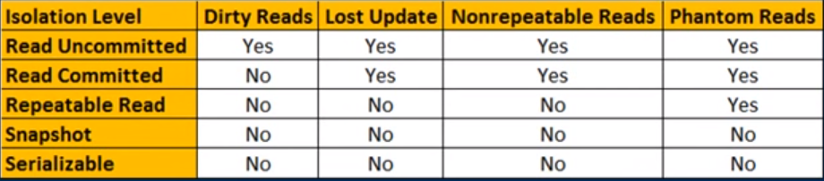
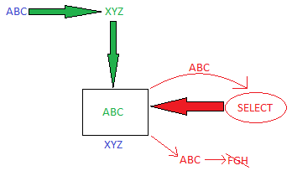
No concurrency side effects for either method
Serialization requires locking of resources. Although there are no concurrency side effects, there are costs to concurrency itself
Snapshot does not lock resources, allowing for an increase in the number of concurrent transactions while providing the same level of data consistency

Slide 5
Example of Serializable Isolation using SQL Server

Slide 6
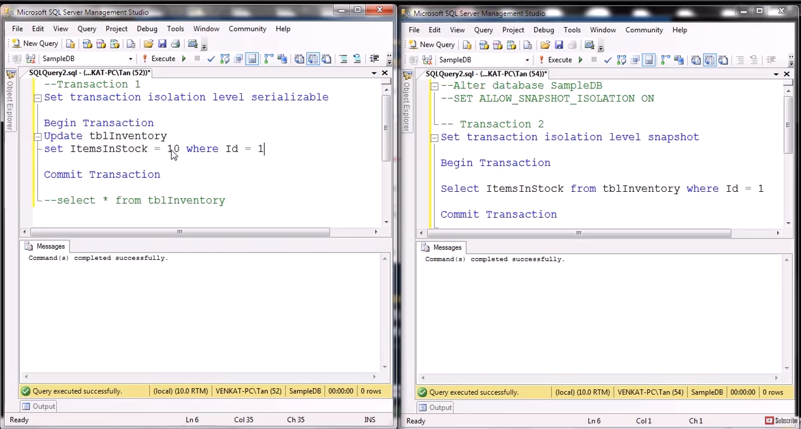
Example of Snapshot Isolation using SQL Server

Slide 7

Snapshot Isolation Code Example in TLA
Time to view some GitHub

Slide 8

Thank You
Booth, Adrian. “Designing Data Intensive Applications: Strong Isolation Using Serializability.” Medium, The Startup, 17 May 2020, https://medium.com/swlh/designing-data-intensive- applications-strong-isolation-using-serializability-8f4994c0834.
Gigoyan, Sergey. “READ_COMMITTED_SNAPSHOT And SNAPSHOT_ISOLATION Levels in SQL Server.” SQL Server Tips, Techniques and Articles, MSSQLTips, 20 Aug. 2020, https://www.mssqltips.com/sqlservertip/6532/readcommittedsnapshot-and- snapshotisolation-levels-in-sql- server/#:~:text=SQL%20Server%20SNAPSHOT%20isolation%20level,achieving%20this%2 0are%20quite%20different.
Kudvenkat, director. Snapshot Isolation Level in SQL Server. YouTube, YouTube, 19 Aug. 2015, https://www.youtube.com/watch?v=9NVu17LjPSA. Accessed 8 Dec. 2022.
will62794. “Snapshot-Isolation-Spec/Snapshotisolation.tla at Master · WILL62794/Snapshot- Isolation-Spec.” GitHub, 28 Feb. 2018, https://github.com/will62794/snapshot-isolation- spec/blob/master/SnapshotIsolation.tla.
Reference Page

